Slide 1
Behavior diagram
Behavior diagrams represent the dynamic aspect of the system.
It emphasizes what must happen in the system being modeled.
Since behavior diagrams illustrate the behavior of a system, they are used extensively to describe the functionality of software systems.
@ShankaragoudaG

Slide 2
Use Case Diagram
Use case diagrams give a graphic overview of the actors involved in a system, different functions needed by those actors and how these different functions interact.
It’s a great starting point for any project discussion because you can easily identify the main actors involved and the main processes of the system.
You can create use case diagrams using our tool and/or get started instantly using our use case templates.

Slide 3
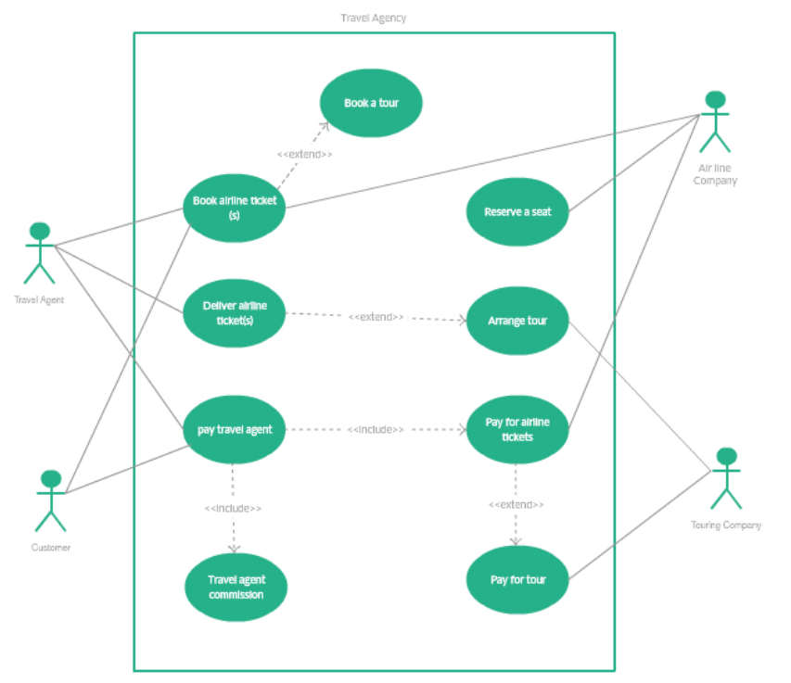
Use Case Diagram

Slide 4
Activity Diagram
Activity diagrams represent workflows in a graphical way.
They can be used to describe the business workflow or the operational workflow of any component in a system.
Sometimes activity diagrams are used as an alternative to State machine diagrams.

Slide 5
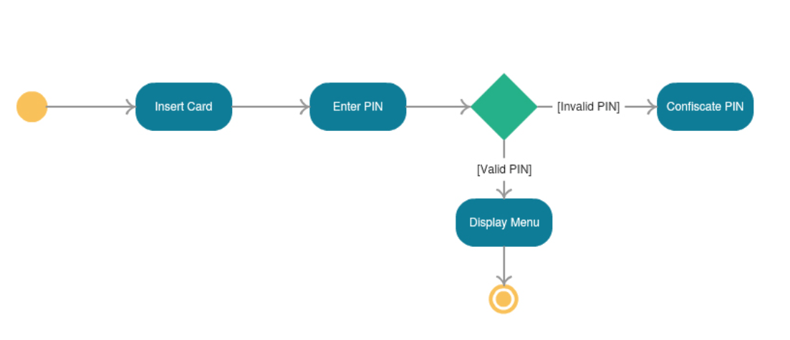
Activity Diagram

Slide 6
State Machine Diagram
State machine diagrams are similar to activity diagrams, although notations and usage change a bit.
They are sometimes known as state diagrams or state chart diagrams as well.
These are very useful to describe the behavior of objects that act differently according to the state they are in at the moment

Slide 7
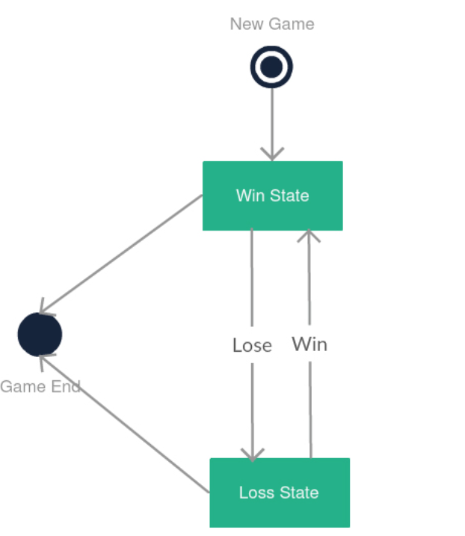
State Machine Diagram

Slide 8
Interaction diagram
Interaction diagrams, a subset of behavior diagrams, emphasize the flow of control and data among the things in the system being modeled.
In simple words, it shows how objects interact with each other and how the data flows within them. It consists of communication, interaction overview, sequence, and timing diagrams.

Slide 9
Interaction diagram - Sequence Diagram
Sequence diagrams in UML show how objects interact with each other and the order those interactions occur.
It’s important to note that they show the interactions for a particular scenario.
The processes are represented vertically and interactions are shown as arrows.

Slide 10
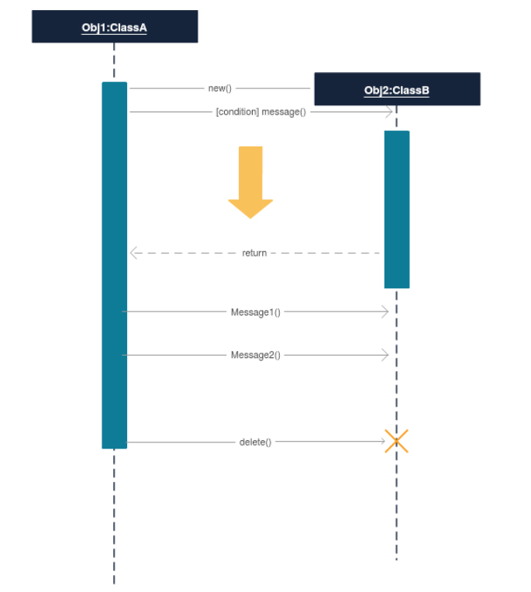
Interaction diagram - Sequence Diagram

Slide 11
Interaction diagram - Communication Diagram
In UML 1 they were called collaboration diagrams.
Communication diagrams are similar to sequence diagrams, but the focus is on messages passed between objects.
The same information can be represented using a sequence diagram and different objects.

Slide 12
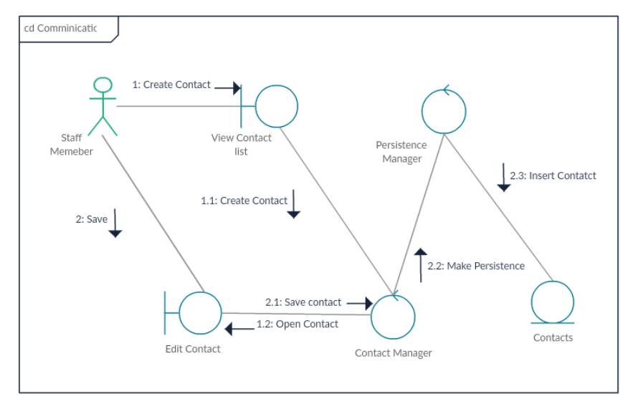
Interaction diagram - Communication Diagram

Slide 13
Interaction diagram – Interaction Overview Diagram
Interaction overview diagrams are very similar to activity diagrams. While activity diagrams show a sequence of processes, Interaction overview diagrams show a sequence of interaction diagrams.
They are a collection of interaction diagrams and the order they happen.
As mentioned before, there are seven types of interaction diagrams, so any one of them can be a node in an interaction overview diagram.

Slide 14
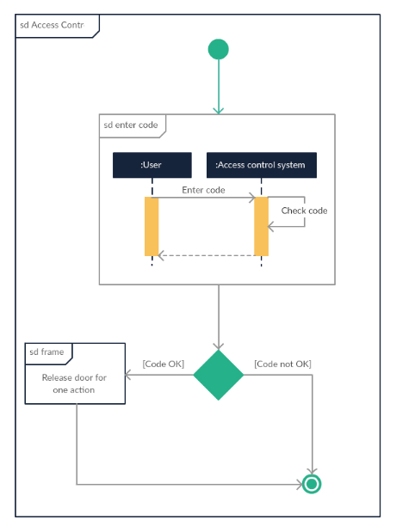
Interaction diagram – Interaction Overview Diagram

Slide 15
Interaction diagram - Timing diagram
Timing diagrams are very similar to sequence diagrams. They represent the behavior of objects in a given time frame.
If it’s only one object, the diagram is straightforward. But, if there is more than one object is involved, a Timing diagram is used to show interactions between objects during that time frame.

Slide 16
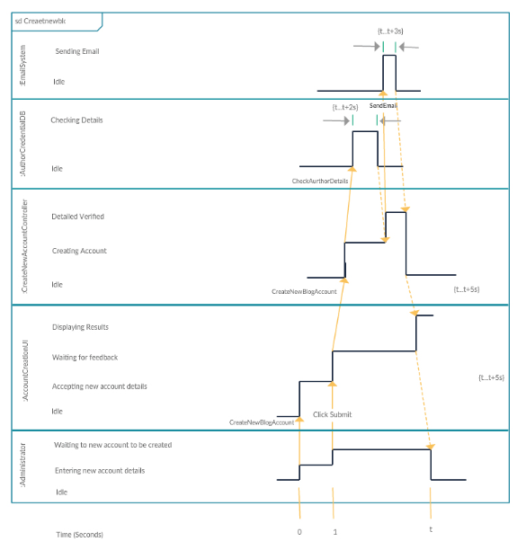
Interaction diagram - Timing diagram

Slide 17
Useful Resources
https://en.wikipedia.org/wiki/Unified_Modeling_Language
https://creately.com/blog/diagrams/uml-diagram-types-examples/
https://www.javatpoint.com/uml-diagrams
https://www.tutorialspoint.com/uml/uml_standard_diagrams.htm

